Slide 1
Jermyn Borough Council Meeting
08/15/2024

Slide 2
Meeting Agenda
August 15,2024
CALL TO ORDER
PLEDGE OF ALLEGIANCE
ROLL CALL
PREVIOUS MEETING MINUTES
TREASURER REPORT/BILLS PAYABLE
SECRETARY REPORT
CORRESPONDENCE
PUBLIC COMMENT
PROFESSIONAL REPORTS-POLICE, FIRE, SOLICITOR, ZONING, ENGINEER, TAX COLLECTOR, MAYOR
COMMITTEE REPORTS-SAFETY, PLANNING, FINANCE, SHADE TREE, REC, MS4, DPW
APPOINTMENT OPEN COUNCIL SEAT
DCED- CFA- MULTIMODAL GRANT
PART TIME CODE ENFORCEMENT
RESOLUTION POLICE PENSION
EXECUTIVE SESSION
NEW BUSINESS

Slide 3
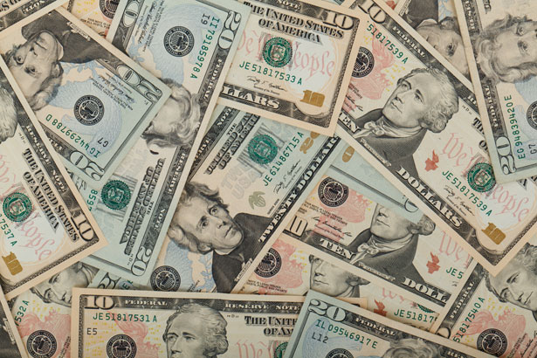
Treasurer’s report
8/15/2024
ASSETS
Checking/Savings
American Rescue Plan Fund 135,764.36
Capital Reserve - DPW 909.60
Capital Reserve - Police 6,049.82
Crime Watch Fund 222.69
General Fund - Community 140,780.12
General Fund - FNB 6,119.23
Holiday Lights Fund 300.59

Slide 4
Treasurer’s report
Investment - General Fund 1,097.46
Investment - Liquid Fuels 24,163.87
Investment - Paving Fund 1,108.89
Investment - Recycling 121.20
Investment - Refuse 172.82
Liquid Fuels - FNB 33,429.67
Petty Cash 196.50
Recreations Fund 22,524.75
Recycling - Community 3,915.08
Refuse Checking - FNB 222,175.09
Total Checking/Savings 599,051.74

Slide 5
Treasurer’s report
200000 · Accounts Payable 15,588.39
Long Term Debt 80,186.16

